Slide 1
Sports screen report generator script map
By: Dan Gregory

Slide 2
Enter patient info
Enter clinical info
Click “Save & Load GCD data”
  Patient info saved automatically
  load_data called
    load_create_patient_data called
      Creates patient folder if one doesn’t exist
      Loads parquet files if they exist
      Returns session_dict with all relevant info
    getData_dialog called
      Opens file explorer to select data
      Checks if date exisits for data in session_dict
      If data exists – either:
        pull gcd data and return in gcd_data
        OR, return empty gcd_data
      If data doesn’t exist, loads gcd data and returns in gcd_data
    If gcd data pulled
      Parse_gcdData called and single/series df’s returned

Slide 3
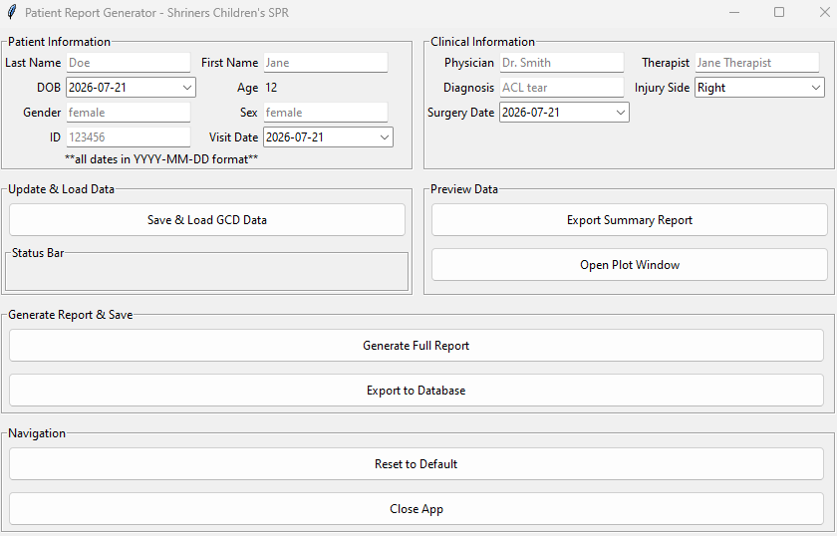
1. Enter patient info
2. Enter clinical info
3. Save patient/clinical info and grab gcd files to load
4. Call to: load_data
4a. Patient info saved via self.patient_data etc. – no function or list used
4b. Call to: load_create_patient_data
*checks for existing folder with patient ID
creates new folder if one doesn’t exist
*checks for existing parquet files
loads all existing data from parquet files including session dates
*returns session_dict – contains session info and full_df
4c. Call to: getData_dialog
*input is session_dict
*checks for overlapping dates
Provides option to add selected data as new visit if date exists – otherwise pulls gcd data
*returns gcd_data and py_data (if py file data exists

